Slide 1
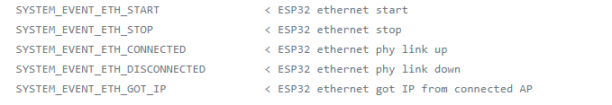
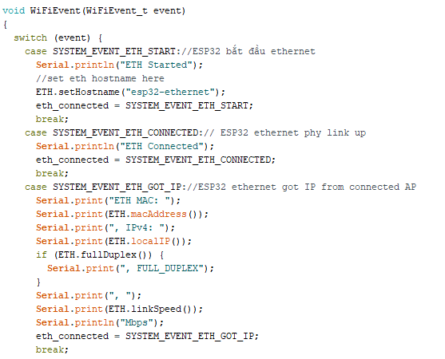
Ethernet gửi dữ liệu lên MQTT

Slide 2
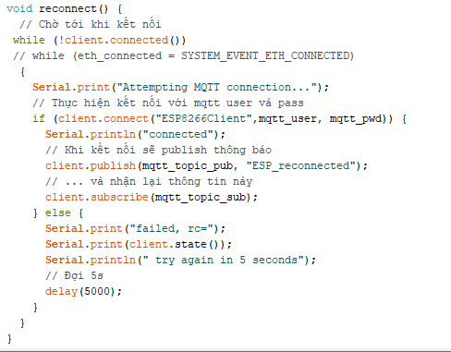
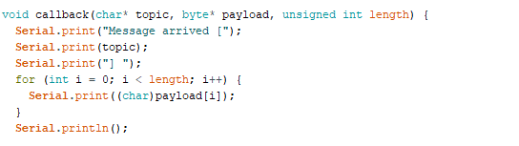

Slide 3
Đổi ssid-pass qua app
WiFi.mode(WIFI_AP_STA): set ESP32 to Station mode (To run SmartConfig it must be set to Station mode)
- WiFi.beginSmartConfig(): start SmartConfig
- WiFi.smartConfigDone(): check whether SmartConfig is done or not

Slide 4
